Slide 1


Alternative Methadone dispensing system
Integrated Opioid Replacement Patient Management System (IORPMS)
Dr. Lyani Sitti
Date: October 2025

Slide 2
Problem Statement
Error-prone manual Excel/paper-based tracking risks duplicate dosing and TCA violations.
Manual inter-departmental referrals
Dispensing delays cause client unrest
Costly non-scalable proprietary software costs:
KES 1.7M setup + KES 250K–800K/year—unaffordable after donor transition.
No MoH reporting or client progress monitoring.
Inadequate technical support and delayed response

Slide 3
Background
IORPMS: A locally developed, free, offline, and open-access semi-automated methadone dispensing system piloted at Shimo La Tewa and Faza clinics.
Key Features:
Digitized Patient Management: One-time registration, role-based access for clinicians, pharmacists, and nurses.
Compliance Safeguards: Automated dose tracking, blocks duplicate dosing, and enforces appointment management.
Prison/Takeaway Module: Supports multi-day dosing with audit trails for accountability.
Cost Reduction: Eliminates licensing fees and reduces equipment costs by 69% through local innovation (e.g., locally assembled infusion pumps).
Interoperability: Aligns with Kenya’s national digital health framework for future integration.
Objectives:
Improve efficiency and accountability in controlled drugs delivery.
Eliminate manual records and reduce reliance on costly software.
Enhance patient verification with fingerprint scanners and real-time analytics.

Slide 4
Benefits
IORPMS: A locally developed, free, offline, and open-access semi-automated methadone dispensing system piloted at Shimo La Tewa and Faza clinics.
Key Features:
Digitized Patient Management: One-time registration, role-based access for clinicians, pharmacists, and nurses.
Compliance Safeguards: Automated dose tracking, blocks duplicate dosing, and enforces Treatment Consent Agreement (TCA) compliance.
Prison/Takeaway Module: Supports multi-day dosing with audit trails for accountability.
Cost Reduction: Eliminates licensing fees and reduces equipment costs by 69% through local innovation (e.g., locally assembled infusion pumps).
Interoperability: Aligns with Kenya’s national digital health framework for future integration.
Objectives:
Improve efficiency and accountability in controlled drugs delivery.
Eliminate manual records and reduce reliance on costly software.
Enhance patient verification with fingerprint scanners and real-time analytics.

Slide 5
How does the system work?
The system focuses on data accuracy, usability and speed. The process of using IORPMS is simple and involves three steps:
Patient identification and verification
Data Processing
Dispensing and clinical follow-up
On average, it takes less than 10 seconds to identify a patient and have a dose dispensed in the system.

Slide 6



How does the system work?
Search patient by:
Name, Unique Identifier (MAT Id), fingerprint
Dispense by:
Syringe or Dispensette –S titration machine
Reports generated:
consumption, patient summary, appointments,
deleted prescriptions, returns, expiries etc
5
seconds
15
seconds
5 - 90
seconds

Slide 7
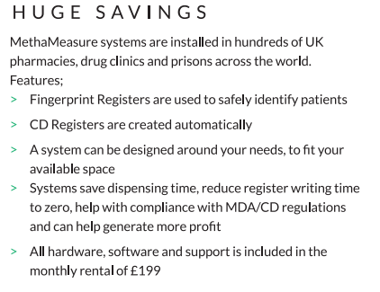
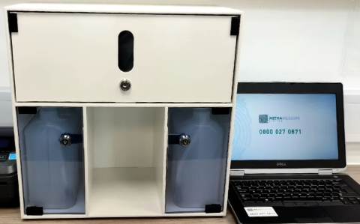
The journey
Methameasure

Slide 8
The journey
Methameasure
Donor-supported
Fully-automated dispensing
Manual reports
Non-scalable
Lack of inter-operability
Manual prescribing/referrals

Slide 9


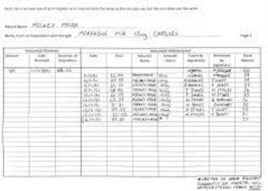
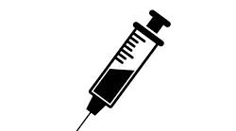
The journey
Limited Waiver - Transition

Slide 10
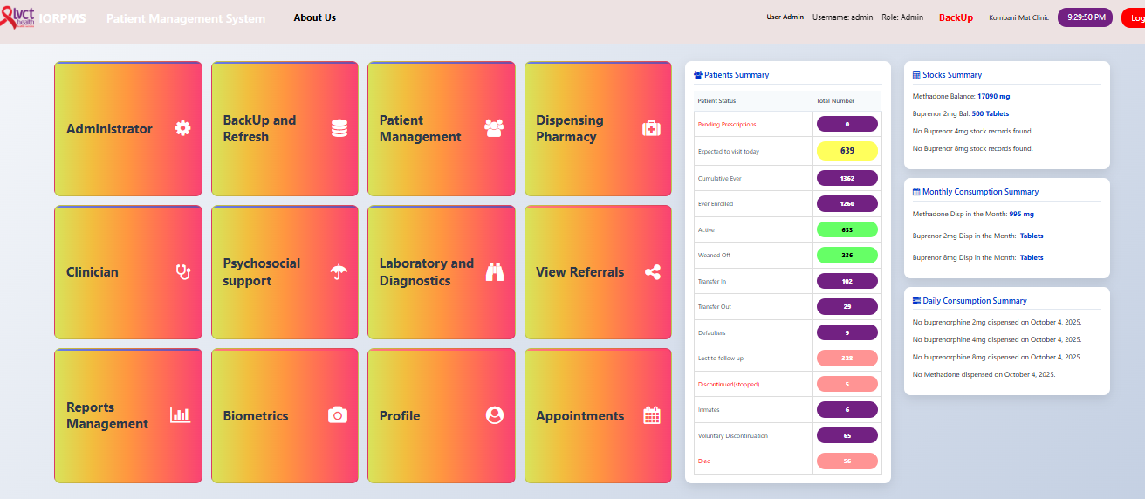
The proposed solution
IORPMS
Integrated PMS
Open-source
Semi-automated dispensing
Automatic reports
Scalable and customizable
Option for inter-operability
Option for pump integration

Slide 11

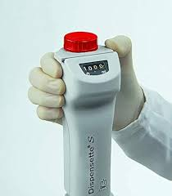


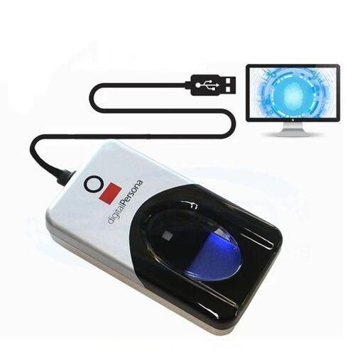
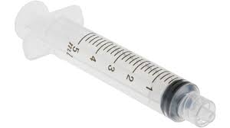
System requirements
Server (XAMPP/WAMP)
MySQL ver 5.2.1 and above
PHP ver 8 and above
Windows 10 and above
RAM at least 4GB
Storage at least 512GB HDD
Hardware requirements

Slide 12
Results
Future Potential
Efficiency Improvements
Eliminated manual Form P5 Excel entries and referrals.
Auto-generated reports for lost-to-follow-up, transit clients, and weaned-off patients.
Streamlined workflows with one-time patient registration and role-based access.
Planned expansion to Miritini MAT Clinic and Kingo'rani Prison and Kiambu County
Integration of biometric authentication and mobile access for community-based follow-ups.
Framework adaptable for other harm reduction therapies.
Cost Savings
Reduced clinic costs by 69% (from USD 21,300 to USD 4,260 per clinic).
Zero licensing fees compared to commercial alternatives (USD 1,200 annually).
Locally assembled infusion pumps can reduce equipment costs from USD 17,000 to USD 1,200.
User Adoption
Achieved 98% user satisfaction due to intuitive UI, online referral capabilities, and TCA-linked dispensing.
Positive feedback from pilots at Shimo La Tewa and Faza Sub-County Hospital.
Accountability:
Automated dose tracking reduced diversion risks.
Prison/takeaway modules ensured compliance with real-time activity logs.

Slide 13
New Facility Systems Implementation Process Plan
A structured roadmap for effective deployment, training, and system rollout.

Slide 14
1. Project Initiation & Planning
Identify stakeholders and define objectives
Form implementation team and develop project charter
Prepare communication and risk management plan
Deliverables: Project charter, work plan, risk matrix
Notes:
Suggested visual: Project timeline visual or stakeholder map

Slide 15
2. Requirements Gathering & System Assessment
Review existing work-flows and systems
Collect user requirements and assess infrastructure
Identify interoperability and data protection needs
Deliverables: Requirements document, gap analysis report
Notes:
Suggested visual: Flowchart showing data flow or requirement mapping

Slide 16
3. System Setup & Installation
Procure missing hardware and install necessary software
Backup data from existing system if any
Configure roles, permissions, and modules
Deliverables: Installation checklist, test report, feedback report
Notes:
Suggested visual: Server setup or configuration dashboard

Slide 17
4. User Training & Capacity Building
Conduct role-based training
Assess user proficiency and collect feedback
Deliverables: Trained users, evaluation report
Notes:
Suggested visual: Training session or classroom image

Slide 18
5. Data Migration & Cleaning
Extract legacy data and clean inconsistencies
Map and migrate validated datasets
Deliverables: Clean data set, migration validation report
Notes:
Suggested visual: Data transformation or database migration diagram

Slide 19
6. On-site Dry Run / Pilot Phase
Run system parallel to existing workflows
Collect user feedback and fix any bugs
Deliverables: Pilot test report
Notes:
Suggested visual: System test or pilot feedback graphic

Slide 20
7. Post-Implementation Monitoring & Support
Track performance, data accuracy, and user adoption
Provide technical and functional support
Deliverables: Monthly reports and performance report
Notes:
Suggested visual: Helpdesk or dashboard analytics image

Slide 21
Summary Timeline
Phase 1: Assessment & Installation (1 day)
Phase 2: Data migration (5 days) – depending on database
Phase 3: Training (2 days)
Phase 4: Dry-run (1 day)
Phase 5: Monitoring (routine)
Phase 6: Reporting (monthly)
Total Duration: 9 days
Notes:
Suggested visual: Gantt chart or timeline visualization

Slide 22
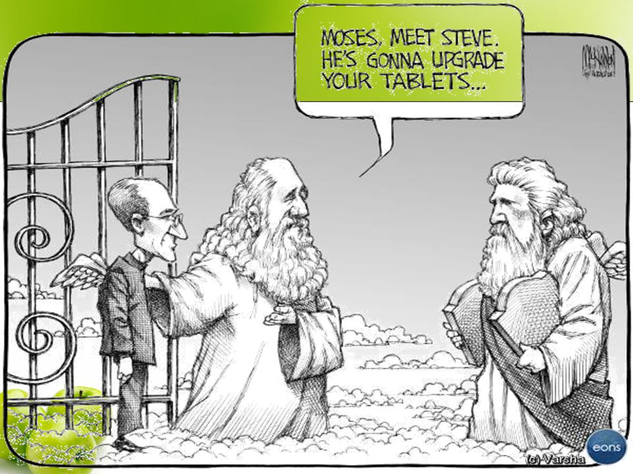
Future improvements
Link with digital automatic pump
What is required
Pumps + Engineers + developers + funds

Slide 23

Proposed non-proprietary name for National rollout
Suggests a smooth, efficient, and streamlined process for prescriptions.
RxFlow
A direct and clear name, combining "opioid" with "Rx" (the medical abbreviation for prescription).
OpioidRx
An acronym for "Medication-Assisted Treatment," a widely recognized term in the field, with "Relief" providing a positive connotation.
ReliefM.A.T.

Slide 24


THANK YOU
Contact us
enquiries@lvcthealth.org
www.lvcthealth.org www.lvctgroup.org www.one2onekenya.org
@LVCTKenya
@lvctKe
LVCTHealth
TheLVCT

